Slide 1


Title: Panorama Image Stitcher
Course Code: CSE 4128
Course Title: Image Processing & Computer Vision Laboratory
Supervised By:
Dr. Sk. Md. Masudul Ahsan
Professor of Department of Computer Science and Engineering
&
Dipannita Biswas
Letcturer of Department of Computer Science and Engineering
Presented by: Sabnaj Akter
Roll: 1907042
Year: 4th
Semester: 1st
Department of Computer Science
and Engineering
Khulna University of Engineering & Technology

Slide 2
OUTLINE
2
Introduction
Application
Key Steps
Methodology Explanation
Input and Result
Limitations
Conclusion
References
6/30/2024

Slide 3
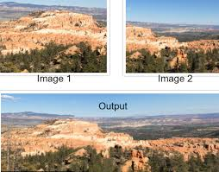
Introduction:
3
Image stitching is the process of combining multiple images to create a single larger image, often referred to as a panorama.
It is done by combining two or more overlapping images
Fig-1:Stitched Image
6/30/2024

Slide 4
Applications:
4
Panoramic Photography and Virtual Tours
Remote Sensing and GIS
Medical Imaging:
Art and Photography
6/30/2024

Slide 5
Key Steps:
5
Image stitching is a multi-step technique that involves the following image-processing operations:
Feature detection
Feature matching
Homography matrix calculation
Blending
Image warping
6/30/2024

Slide 6
Methodology(Features Detection):
6
SHIFT (scale-invariant feature transform) algorithm is used to detect key points and features.
SHIFT algorithm steps:
Keypoints Detection
Image Pyramids: The algorithm creates a pyramid of images by repeatedly applying Gaussian blurring and subsampling to the original image
Difference of Gaussians (DoG): Within each scale level of the pyramid, SIFT computes the Difference of Gaussians (DoG) by subtracting adjacent levels of Gaussian blurred images
Keypoints Localization: Each pixel in the DoG images, it is compared with its 26 neighbors . If the pixel value is the maximum or minimum among its neighbors, it is considered a keypoint candidate.
6/30/2024

Slide 7
Methodology(Features Detection):
7
Feature Description: Each keypoint is described by a robust feature vector (descriptor) that captures its local appearance, orientation, and structural information through gradient histograms.
Gradient Calculation: For each keypoint, the gradient magnitude and direction are computed in its neighborhood (usually a 16x16 window)
Histogram Accumulation: A histogram of gradient orientations is constructed, where each orientation bin accumulates gradient magnitudes weighted by their orientations.
Multiple Orientations: If there are multiple peaks within 80% of the highest peak, multiple orientations are assigned to the keypoint to improve matching robustness.
6/30/2024

Slide 8
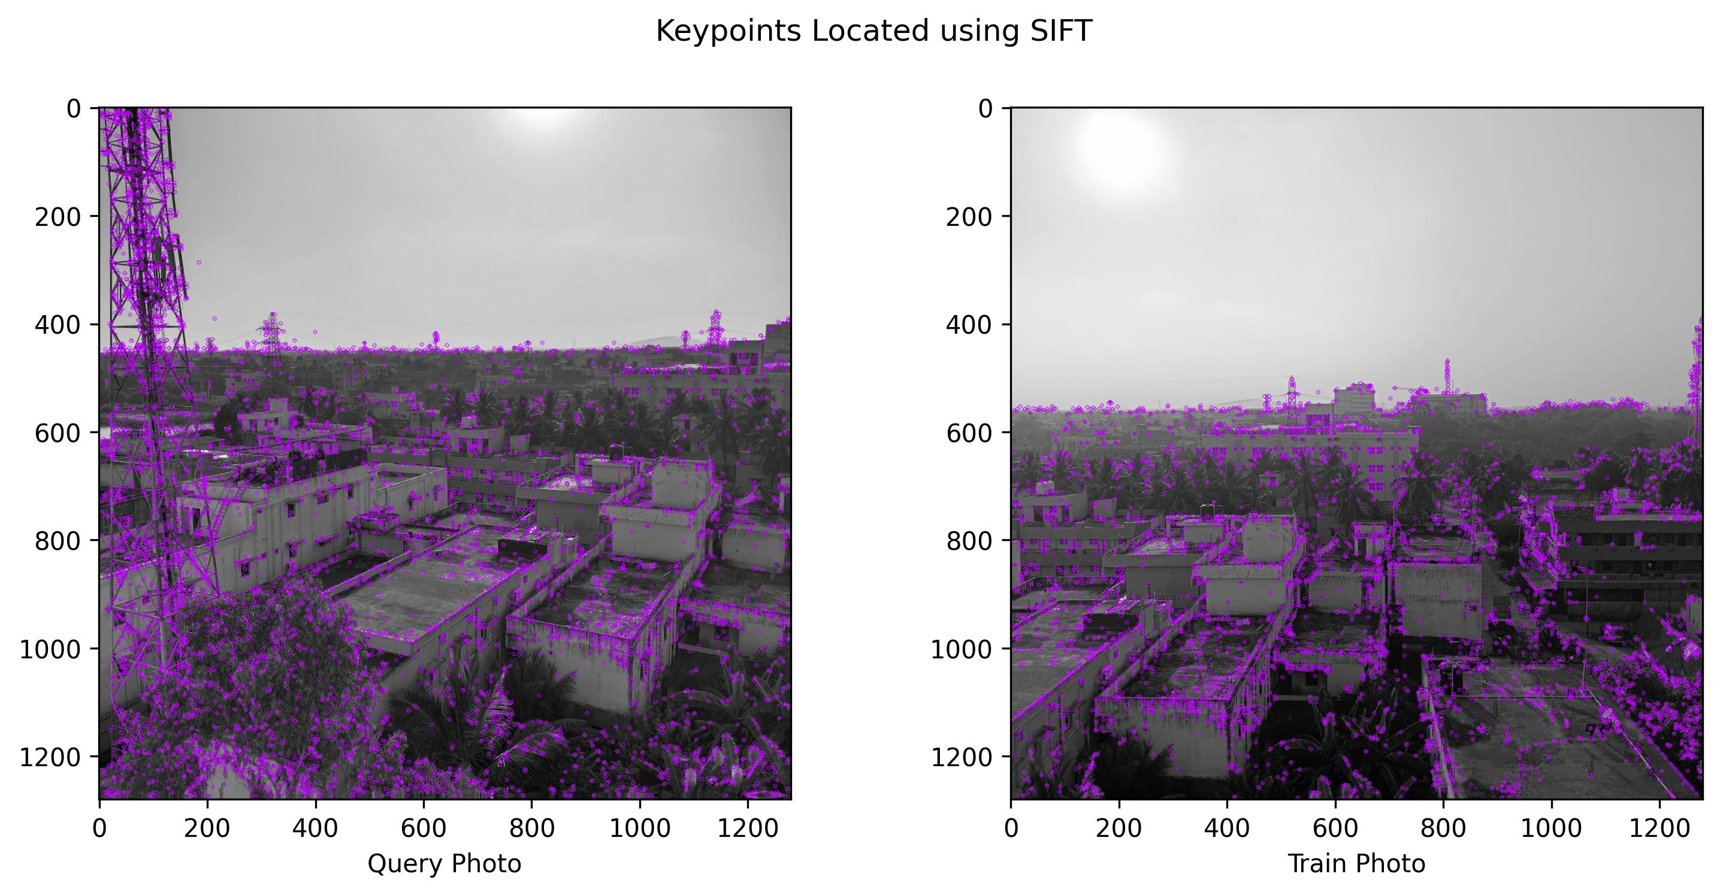
Methodology (Features Detection):
8
FIg-2: Keypoints
6/30/2024

Slide 9
Methodology (Feature Matching):
9
Apply Brute Force: Using Brute Force Matching, each feature descriptor in one image is compared to every feature descriptor in the other image.
Calculate Distance: For each feature descriptor, calculate its distance(Euclidian distance) to every feature descriptor in the second set
Best Match: Find the best match which has least distance
Threshold Apply: Apply a threshold to filter out matches that exceed a certain distance
Sort Matches: Sort matches based on their distance or similarity score for further processing.
6/30/2024

Slide 10
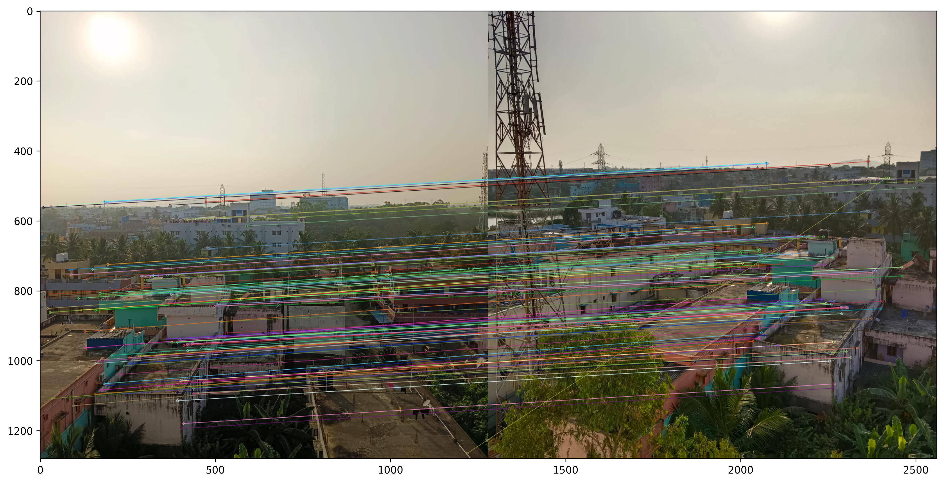
Methodology(Feature Matching):
10
FIg-3: Mapped Keypoints
6/30/2024

Slide 11
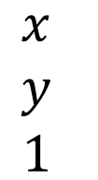
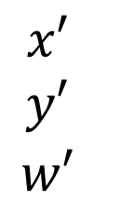
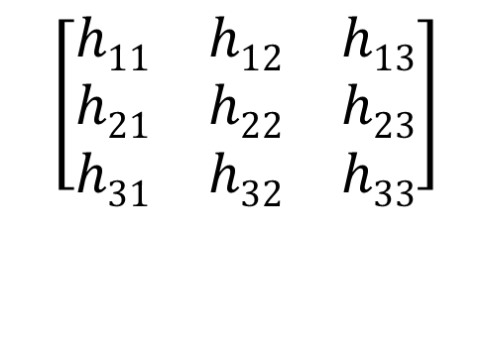
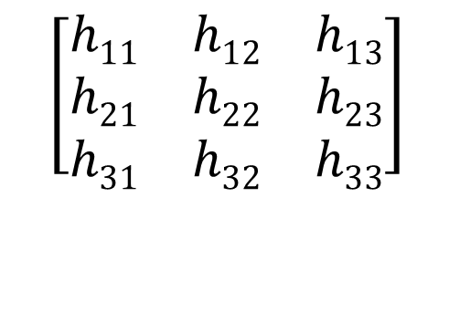
Methodology (Homography Matrix Calculation):
11
.
The homography matrix,often denoted as H, describes the geometric relationship between corresponding points in the two images.
The homography matrix is a 3x3 matrix and can be represented as:
$$\left[\begin{matrix}h11 & h12 & h13 \\ h21 & h22 & h23 \\ h31 & h32 & h33\end{matrix}\right]$$
H=
Homography Transformation Equation:
$$\begin{matrix}x′ \\ y′ \\ w′\end{matrix}$$
$$\left[\begin{matrix}h11 & h12 & h13 \\ h21 & h22 & h23 \\ h31 & h32 & h33\end{matrix}\right]$$
$$\begin{matrix}x \\ y \\ 1\end{matrix}$$
=
.
6/30/2024

Slide 12
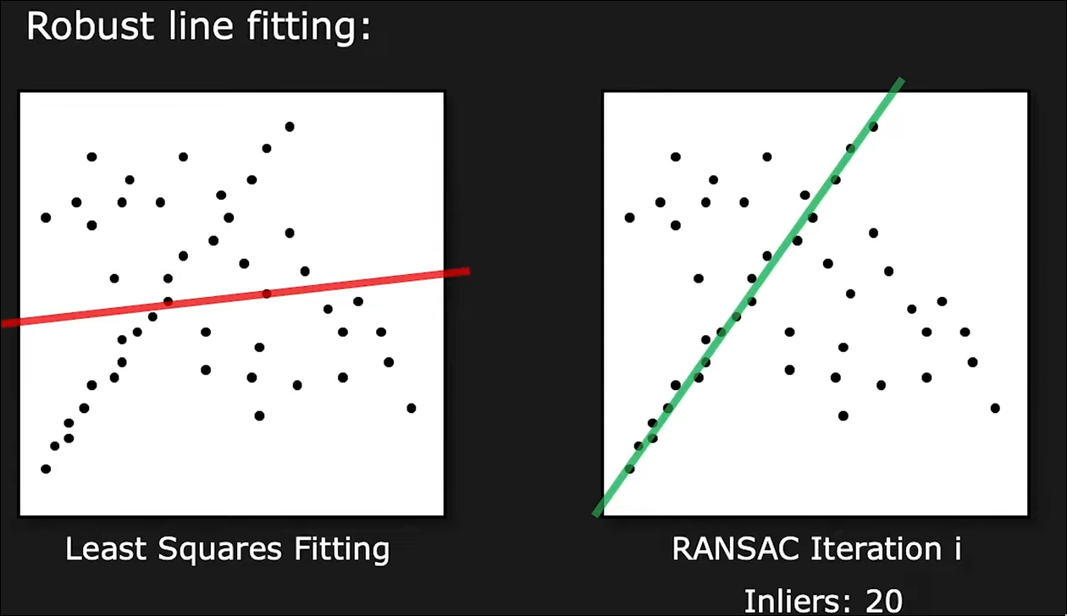
Methodology (Homography Matrix Calculation):
12
.
RANSAC algorithm is used to find the value of homography matrix
It is an iterative algorithm commonly used in
RANSAC is often used when dealing with correspondences between points in two images that may include outliers or mismatches.
FIg-4: RANSAC apply
6/30/2024

Slide 13
Methodology (Wrapping Image):
13
The wrap operation is crucial in image stitching to ensure that the images align correctly.
The wrrap operation applies homgraphy matrix H to transform the perspective of one image to align with another.
By transforming the image, the wrap operation aligns the features (like edges, corners, and other keypoints) of one image with the corresponding features in the other image.
The Homography matrix H defines how the perspective of the image changes.
6/30/2024

Slide 14
Methodology (Blending):
14
Why blending is important?
The image may have different contrast or brightness for capturing different viewpoints
To solve this issue weighted blending is used
Weighted Blending:
Linear gradient mask is created
This mask is converted into 3 channel(BGR) by duplicating
This mask is applied to blending image.
Blending operation is done by multipying each image by its crossepoding mask(element wise multiplication)
6/30/2024

Slide 15
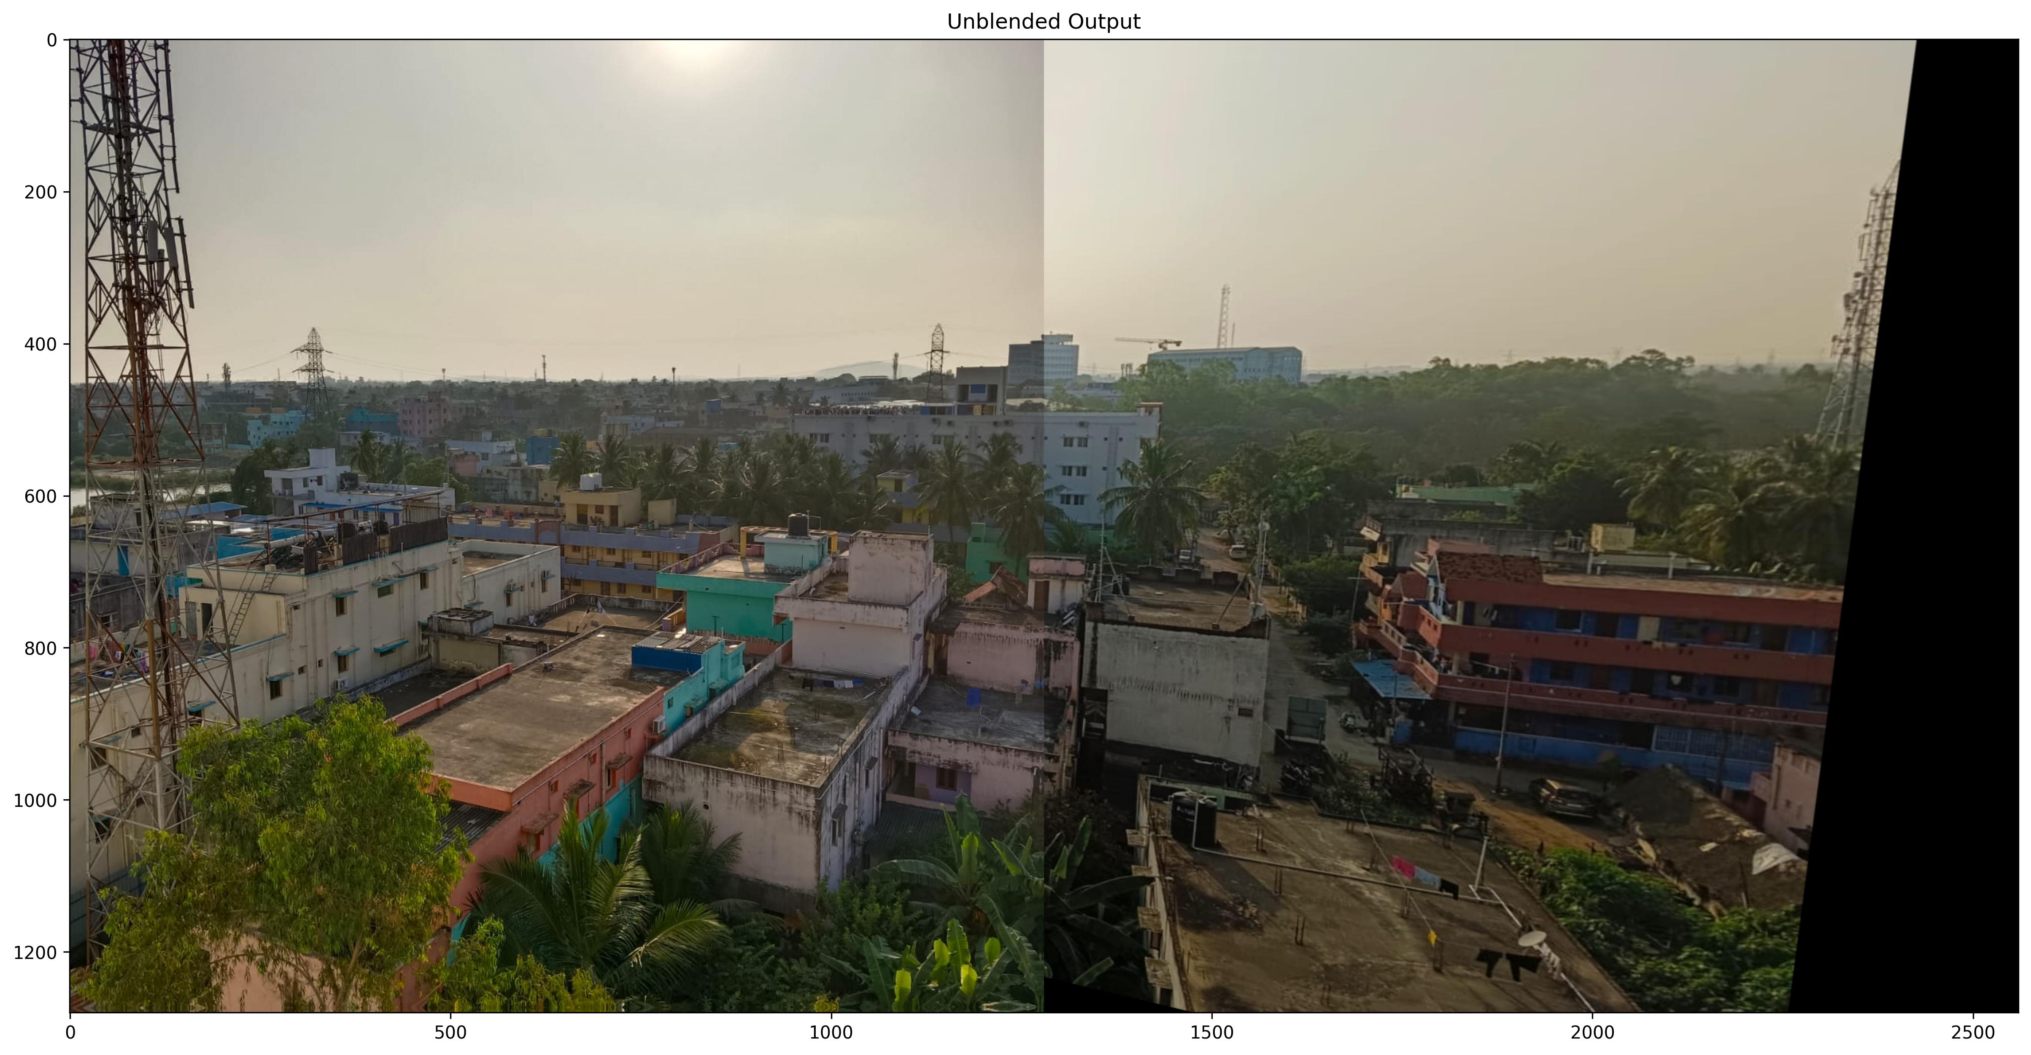
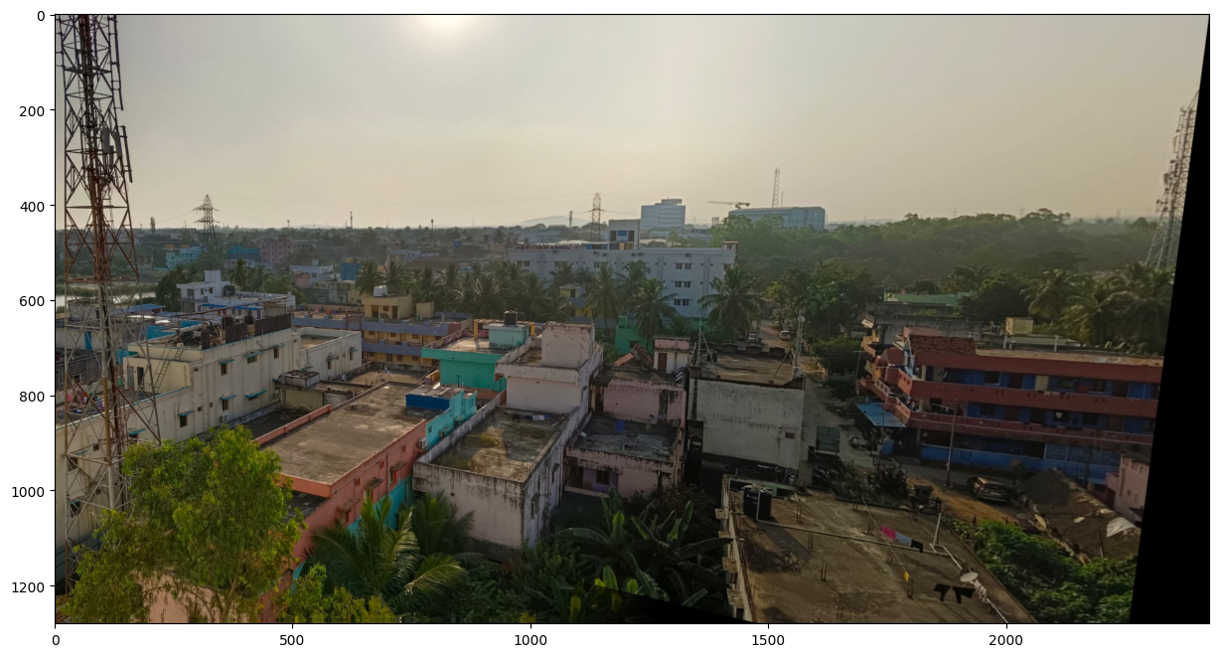
Methodology (Blending):
15
FIg-5: Before blending
FIg-6: After Blending
6/30/2024

Slide 16
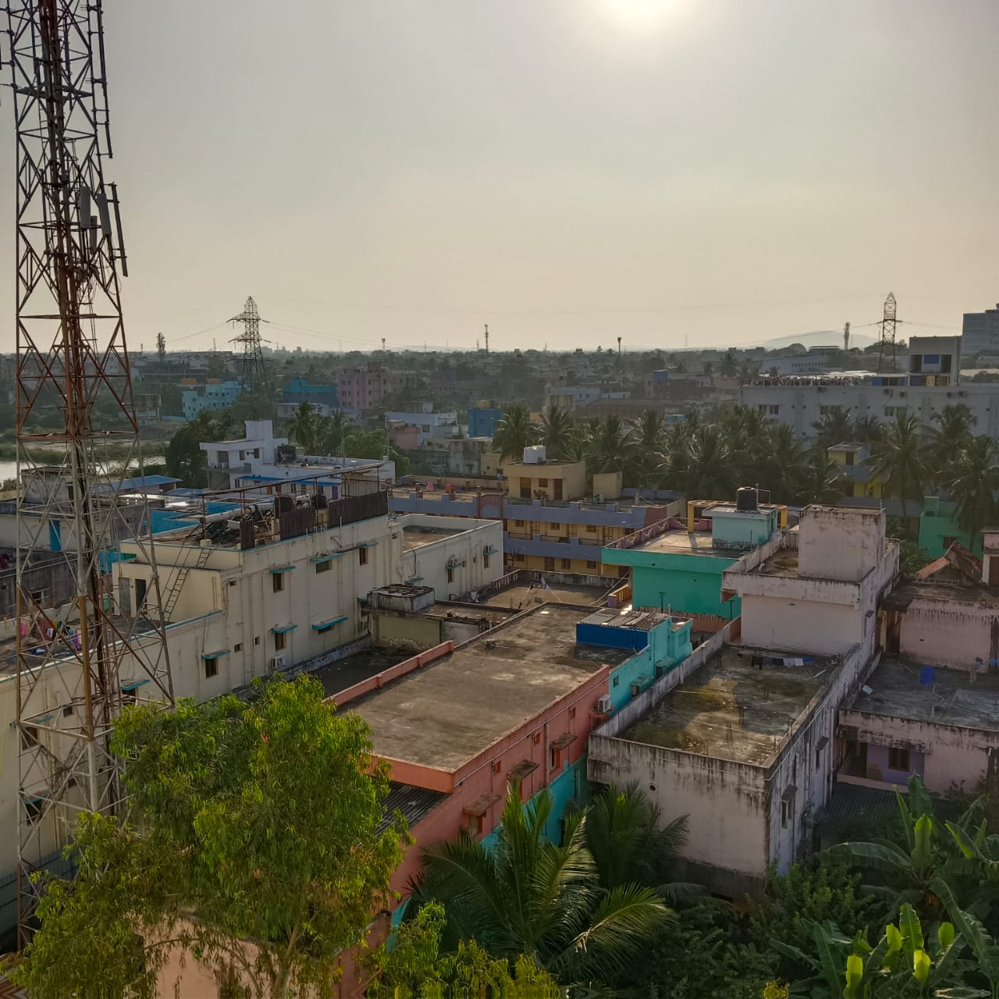
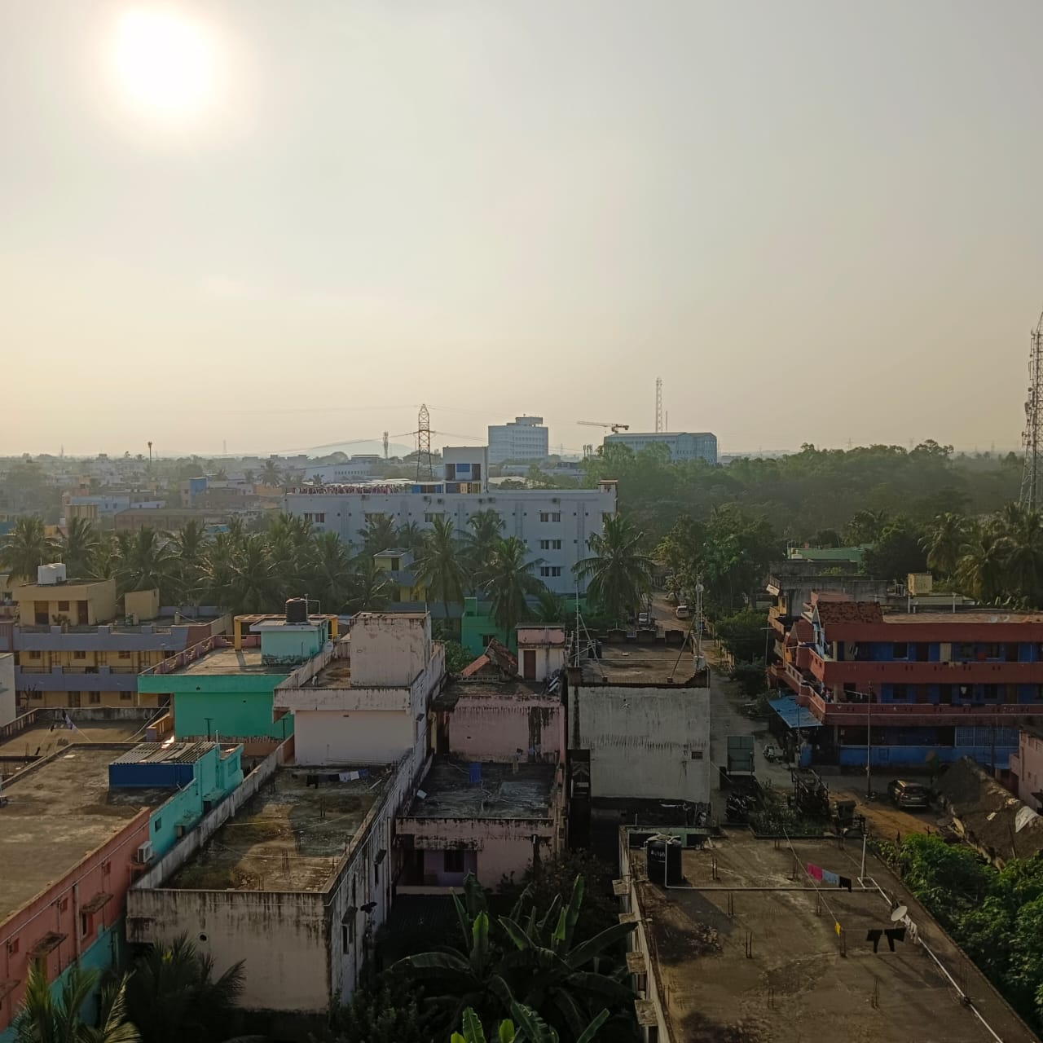
Result :
16
Input Image:
FIg-7: Left Image
FIg-8: Right Image
6/30/2024

Slide 17
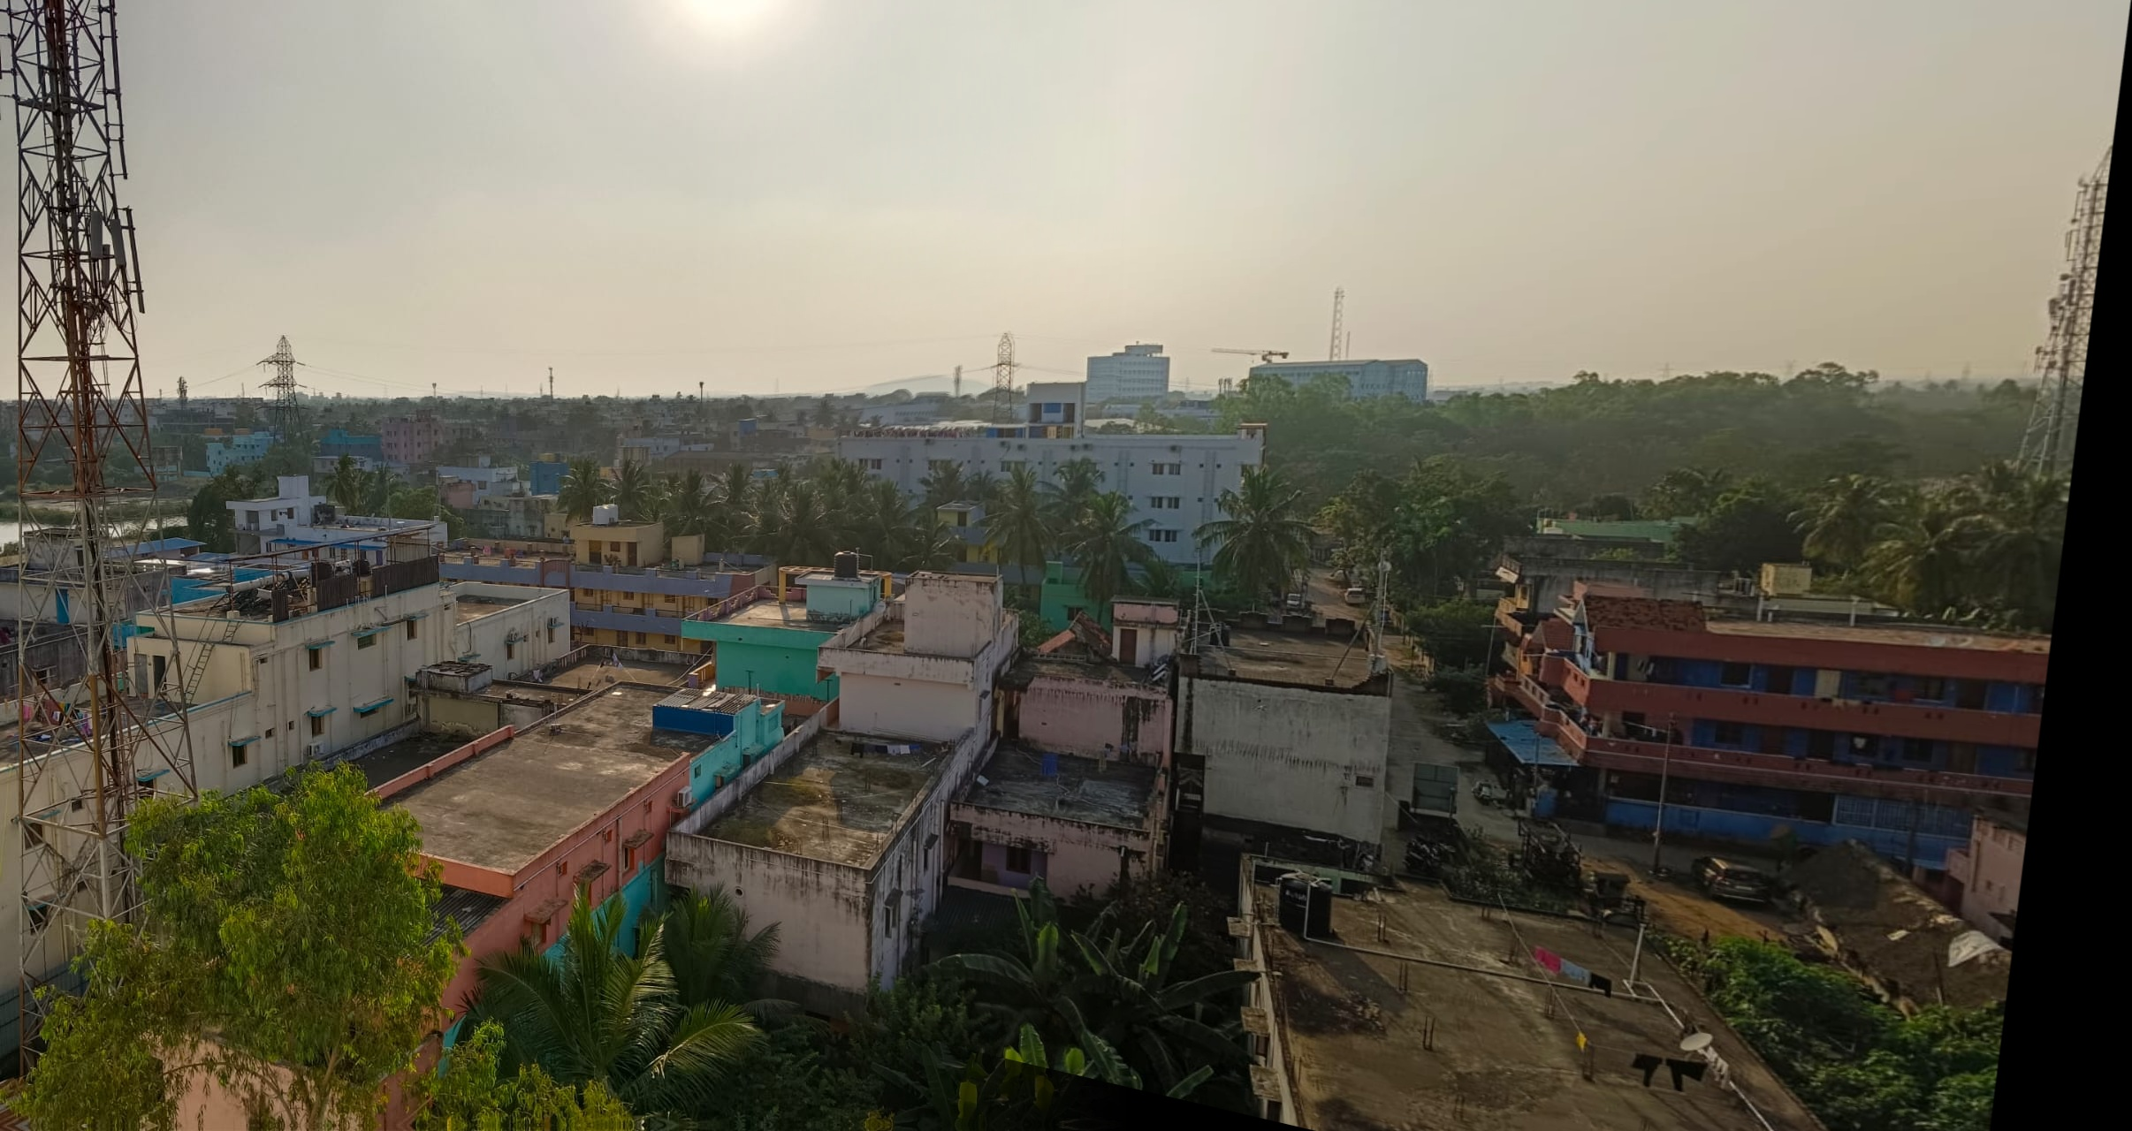
Result :
17
Output image:
FIg-9: Output Imae
6/30/2024

Slide 18
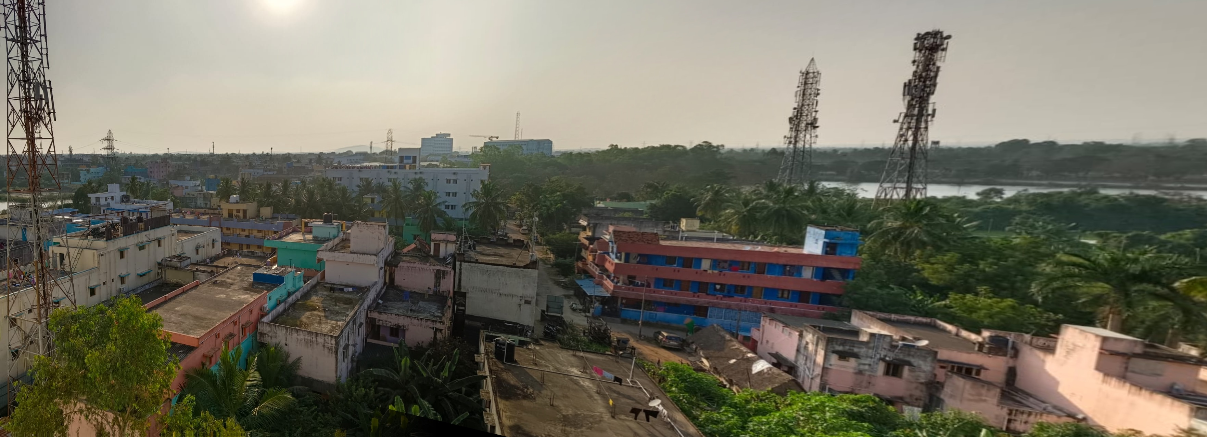
Result :
18
Stitching multiple images using recursion we can obtain a wider panorama:
FIg-9:Wide Output Image
6/30/2024

Slide 19
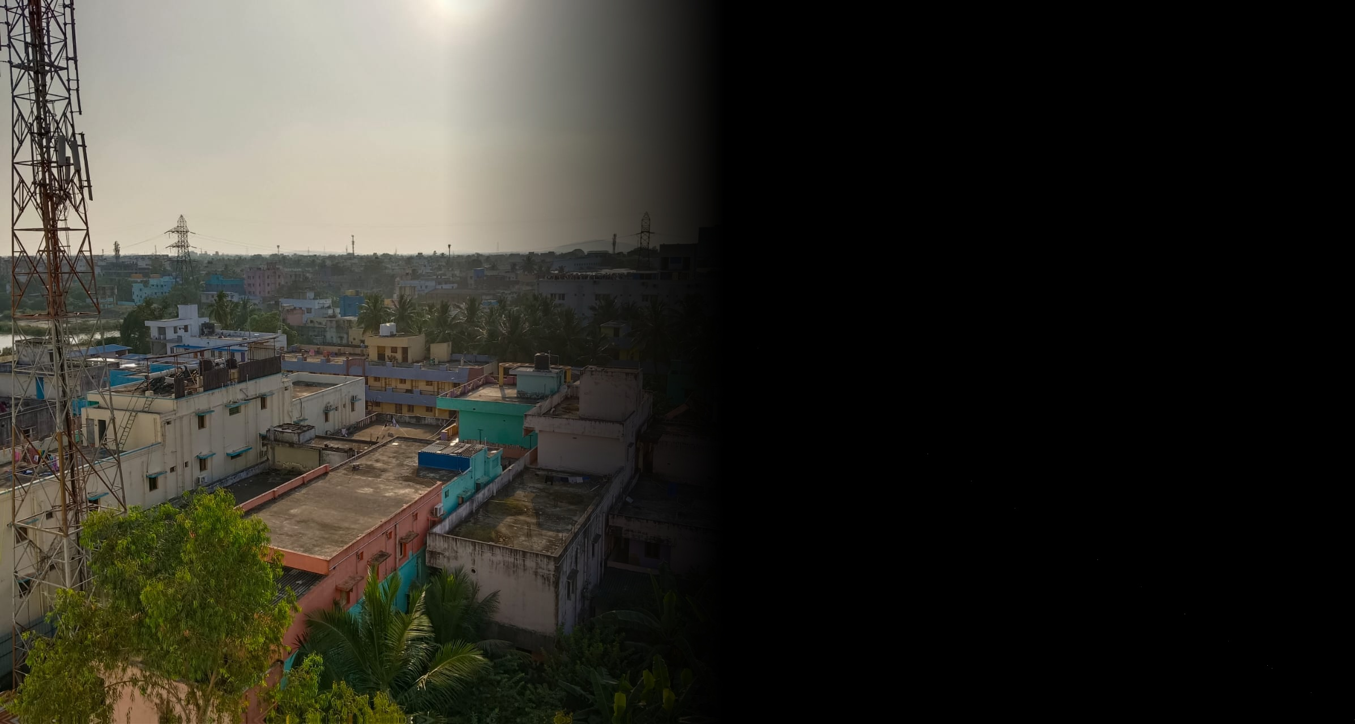
Limitations :
19
If there is not enough overlapping area it still stitch the image and give a dark area in the stitching region
Fig 10:Output of not overlapping input images
6/30/2024

Slide 20
Conclusion:
20
The approach for image stitching was studied.
A thorough description of their methodology was given.
The stitcher is able to stitching multiple image
Maximum used funcitons are useer define
6/30/2024

Slide 21
References:
21
[1] IEEE Xplore, delivering full text access to the world&#x27;s highest quality technical literature in engineering and technology. | IEEE Xplore
[2]“Automatic Panoramic Image Stitching using Invariant Features”, International Journal of Computer Vision, Jan. 01, 2006. [Online]. Available: https://doi.org/10.1007/s11263-006-0002-3 [3]“A Review Over Panoramic Image Stitching Techniques”, International Journal of Computer Vision, Jan. 01, 2006. [Online]. Available: https://doi.org/10.1007/s11263-006-0002-3
[4] Farhadi, Ali, et al. ”Every picture tells a story: Stitching multiple image ” Euro-pean conference on computer vision. Springer, Berlin, Heidelberg, 2010.
[5] O. Vinyals, A. Toshev, S. Bengio et al., "Show and tell: Lessons learned from the 2015 MSCOCO Detiecting feture using shift and stitching image ", IEEE Transactions on Pattern Analysis and Machine Intelligence, vol. 39, no. 4, 2017.
6/30/2024

Slide 22
22
THANK YOU
6/30/2024

